Slide 1
Unit No. 4
Database Security and Authorization
Prepared by: Mr. A. R. Pradnyavant

Slide 2
Contents
Introduction to Database Security
Access Control
Discretionary Access Control
Mandatory Access Control
Audit Trails in Databases
Statistical Databases
Prepared by: Mr. A. R. Pradnyavant

Slide 3
Introduction to DB Security
There are three main objectives when designing a secure database application
Secrecy: Users should not be able to see things they are not supposed to.
  E.g., A student can’t see other students’ grades.
Integrity: Users should not be able to modify things they are not supposed to.
  E.g., Only instructors can assign grades.
Availability: Users should be able to see and modify things they are allowed to.
Prepared by: Mr. A. R. Pradnyavant

Slide 4
We use following schemas in our examples;
Sailors(sid: integer, sname: string, rating: integer, age: real)
Boats(bid: integer, bname: string, color: string)
Reserves( sid: integer, bid: integer, day: dates)
Prepared by: Mr. A. R. Pradnyavant

Slide 5
Access Controls
A database for an enterprise contains a great deal of information and has several group of users.
Most of the users need to access only a small part of database to carry out their task
DBMS should provide mechanisms to control access to data
A security mechanism allows us to enforce a chosen security policy.
A DBMS offers two main approaches to access control
  Discretionary access control: Distraction of user-(freedom to decide what should be done)
  Mandatory access control : compulsory
Prepared by: Mr. A. R. Pradnyavant

Slide 6
Discretionary Access Control
Based on the concept of access rights or privileges for objects (tables and views), and mechanisms for giving users privileges (and revoking privileges).
Creator of a table or a view automatically gets all privileges on it.
  DMBS keeps track of who subsequently gains and loses privileges, and ensures that only requests from users who have the necessary privileges (at the time the request is issued) are allowed.
Prepared by: Mr. A. R. Pradnyavant

Slide 7
GRANT Command
The following privileges can be specified:
  SELECT: Can read all columns (including those added later via ALTER TABLE command).
  INSERT(col-name): Can insert tuples with non-null or non-default values in this column.
    INSERT means same right with respect to all columns.
  DELETE: Can delete tuples.
  REFERENCES (col-name): Can define foreign keys (in other tables) that refer to this column.
If a user has a privilege with the GRANT OPTION, can pass privilege on to other users (with or without passing on the GRANT OPTION).
Only owner can execute CREATE, ALTER, and DROP.
GRANT privileges ON object TO users [WITH GRANT OPTION]
Prepared by: Mr. A. R. Pradnyavant

Slide 8
Example of view
CREATE VIEW EMPSALES ( name, age, salary)
As SELECT E.name, E.age, S.salary
From EMPLOYE E, SELES s
WHERE
E.id= s.id & E. age>20
Prepared by: Mr. A. R. Pradnyavant

Slide 9
GRANT and REVOKE of Privileges
GRANT INSERT, SELECT ON Sailors TO Horatio
  Horatio can query Sailors or insert tuples into it.
GRANT DELETE ON Sailors TO sham WITH GRANT OPTION
  sham can delete tuples, and also authorize others to do so.
GRANT UPDATE (rating) ON Sailors TO Dustin
  Dustin can update (only) the rating field of Sailors tuples.
GRANT SELECT ON ActiveSailors TO Guppy, Yuppy
  This does NOT allow the ‘uppies to query Sailors directly!
REVOKE: A User who has granted a privilege to another user may change his or her mind and want to withdrow the granted privileges
Prepared by: Mr. A. R. Pradnyavant

Slide 10
Example
Joe/ GRANT SELECT ON Sailors To Art WITH GRANT OPTION
Art/ GRANT SELECT ON Sailors To Bob WITH GRANT OPTION
Joe/ REVOKE SELECT ON Sailors FROM Art CASCADE
of Course, Art loses SELECT Privileges on Sailors
Also bob loses SELECT Privileges
Called as Abandoned
Prepared by: Mr. A. R. Pradnyavant

Slide 11
RESTRICT/ CASCADE
If we use the RESTRICT Keyword, the privilege will be revoked only from Specific user.
If we use CASCADE, If will revoke the privilege and any dependent privilege as a result of your Grant.
Prepared by: Mr. A. R. Pradnyavant

Slide 12
GRANT/REVOKE on Views
If the creator of a view loses the SELECT privilege on an underlying table, the view is dropped!
If the creator of a view loses a privilege held with the grant option on an underlying table, (s)he loses the privilege on the view as well; so do users who were granted that privilege on the view!
Prepared by: Mr. A. R. Pradnyavant

Slide 13
Views and Security
Views can be used to present necessary information (or a summary), while hiding details in underlying relation(s).
  Given ActiveSailors, but not Sailors or Reserves, we can find sailors who have a reservation, but not the bid’s of boats that have been reserved.
Creator of view has a privilege on the view if (s)he has the privilege on all underlying tables.
Together with GRANT/REVOKE commands, views are a very powerful access control tool.
Prepared by: Mr. A. R. Pradnyavant

Slide 14
Role-Based Authorization
In SQL-92, privileges are actually assigned to authorization ids, which can denote a single user or a group of users.
In SQL:1999 (and in many current systems), privileges are assigned to roles.
  Roles can then be granted to users and to other roles.
  Reflects how real organizations work.
  Illustrates how standards often catch up with “de facto” standards embodied in popular systems.
Prepared by: Mr. A. R. Pradnyavant

Slide 15
Security to the Level of a Field!
Can create a view that only returns one field of one tuple. (How?)
Then grant access to that view accordingly.
Allows for arbitrary granularity of control, but:
  Clumsy to specify, though this can be hidden under a good UI
  Performance is unacceptable if we need to define field-granularity access frequently. (Too many view creations and look-ups.)
Prepared by: Mr. A. R. Pradnyavant

Slide 16
Authorization Graph
In which the nodes are users—technically, they are authorization IDs—and the arcs indicate how privilege are passed
There is an arc from (the node for) user 1 to user 2 if user 1 executed a GRANT command giving privilege to user 2
The arc is labeled with descriptor for the GRANT command
Prepared by: Mr. A. R. Pradnyavant

Slide 17
Example Authorization Graph
Joe/ GRANT SELECT ON Sailors To Art WITH GRANT OPTION
Art/ GRANT SELECT ON Sailors To Bob WITH GRANT OPTION
Bob/ GRANT SELECT ON Sailors To Art WITH GRANT OPTION
Joe/ GRANT SELECT ON Sailors To Cal WITH GRANT OPTION
Cal / GRANT SELECT ON Sailors To Bob WITH GRANT OPTION
Joe/ REVOKE SELECT ON Sailors FROM Art CASCADE
Prepared by: Mr. A. R. Pradnyavant

Slide 18
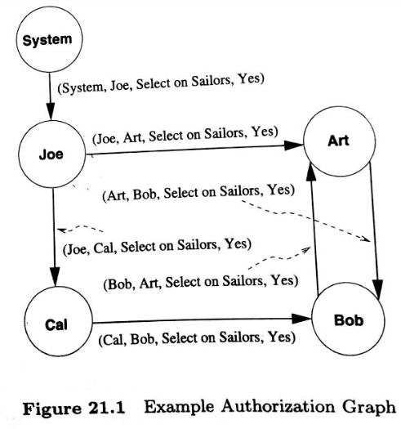
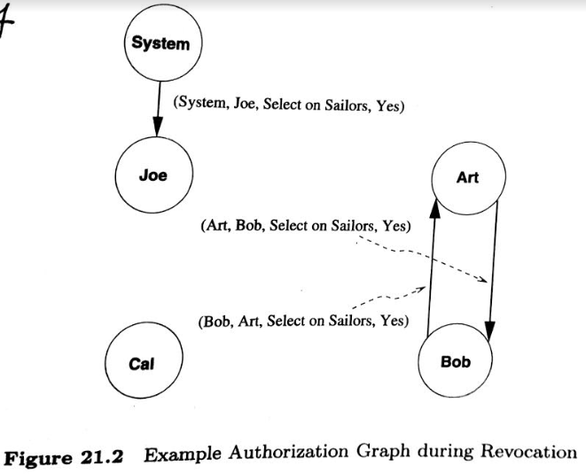
Example Authorization Graph
Prepared by: Mr. A. R. Pradnyavant

Slide 19
Grant and Revoke on Views and Integrity Constraints
The privileges held by the creator of a view (with respect to the view) change over time as he or she gains or loses privileges on the underlying tables.
If the creator loses a privilege held with the grant option, users who were given that privilege on the view lose it as well.
GRANT and REVOKE commands when they involve views or integrity constants.
Prepared by: Mr. A. R. Pradnyavant

Slide 20
Suppose Joe has created the table Boats, Reserves & Sailors
Example
GRANT INSERT , DELETE ON Reserves TO Yuppy WGO
Yoppy can insert or delete Reserves rows & authorize Someone else to do the same.
GRANT SELECT ON Reserves To Michael
GRANT SELECT ON SAILOR To Michael WGO
GRANT UPDATE ON SAILOR To Leah
GRANT REFERENCE ON Boats to Bill
Suppose Michael Creates the following View
CREATE VIEW YoungSailors ( Sid, age, rating)
As SELECT S.sid, S.age,S.rating
From sailors S
WHERE
S.age<18
Prepared by: Mr. A. R. Pradnyavant

Slide 21
Here, table is sailor, for which Michael has
SELECT WITH GRANT OPTION
He have SWGO on YungSailor
So he can pass the SELECT Privileges to other say art.
However, Art do not have the right
To executes SELECT Queries directly on Sailors Table
Prepared by: Mr. A. R. Pradnyavant

Slide 22
NOW ,
GRANT INSERT ON Sailors To Michael
Suppose, this Command gets executed & then a column is added to Sailors
(by Executing ALTER Table Command)
Note that Michael has the INSERT Privilege with respect to newly added column
If we execute following command instead of previous one
Michael would not have the INSERT Privilege on new column
GRANT INSERT ON Sailors (Sid), Sailors(sname),
Sailors (ratings), Sailors (age)
To Michael.
Prepared by: Mr. A. R. Pradnyavant

Slide 23
Role of a Database Administrator
DBA has important role in enforcing the security related aspects of a database design
DBA has special account called system account and responsible for overall security of the system
DBA Deals with following
Creating new accounts:-
Each new user or group of users must be assigned an authorization ID and a password
Mandatory control : Compulsory
DBA is also responsible for maintaining Audit Trail:
Record of system who did what and when
Prepared by: Mr. A. R. Pradnyavant

Slide 24
Mandatory Access Control: Compulsory
System wide policies that cannot be changed by individual users
Security class is assigned to each db objects
Only administrator manages the access controls
Administrator: define the usage and access policy, which cannot be modified or changed by user
Access to programs and file.
Prepared by: Mr. A. R. Pradnyavant

Slide 25
Mandatory Access Control
Based on system-wide policies that cannot be changed by individual users.
  Each DB object is assigned a security class.
  Each subject (user or user program) is assigned a clearance for a security class.
  Rules based on security classes and clearances govern who can read/write which objects.
Most commercial systems do not support mandatory access control. Versions of some DBMSs do support it; used for specialized (e.g., military) applications
Prepared by: Mr. A. R. Pradnyavant

Slide 26
Why Mandatory Control?
Discretionary control has some flaws, e.g., the Trojan horse problem:
  Dick creates Horsie and gives INSERT privileges to Justin (who doesn’t know about this).
  Dick modifes the code of an application program used by Justin to additionally write some secret data to table Horsie.
  Now, Justin can see the secret info.
The modification of the code is beyond the DBMSs control, but it can try and prevent the use of the database as a channel for secret information.
Prepared by: Mr. A. R. Pradnyavant

Slide 27
Bell-LaPadula Model
Objects (e.g., tables, views, rows, columns)
Subjects (e.g., users, user programs)
Security classes:
  Top secret (TS), secret (S), confidential (C), unclassified (U): TS > S> C > U
Each object and subject is assigned a class.
  Subject S can read object O only if class(S) >= class(O) (Simple Security Property)
  Subject S can write object O only if class(S) <= class(O) (*-Property)
Prepared by: Mr. A. R. Pradnyavant

Slide 28
Multilevel Relations and Polyinstantion
bid
bname
color
class
Users with S and TS clearance will see both rows; a user with C will only see the 2nd row; a user with U will see no rows.
If user with C tries to insert <101,Pasta,Blue,C>:
  Allowing insertion violates key constraint
  Disallowing insertion tells user that there is another object with key 101 that has a class > C!
  Problem resolved by treating class field as part of key.
101
Salsa
Red
S
102
Pinto
Brown
C
Prepared by: Mr. A. R. Pradnyavant

Slide 29
Statistical DB Security
A Statistical database contains specific information on individuals or events but is intended to permit only statistical queries
For example:
Avg age than rather than joes age
for ex. If we maintained statistical database of information about Sailors, we can write statistical queries about avg ratings, max.age and so on.
But not queries about individual sailors
Prepared by: Mr. A. R. Pradnyavant

Slide 30
Statistical database
Security in such databases poses some new problems because it is possible to infer protected information (such as an individual sailor's rating) from answers
Such inference opportunities that can compromise the security policy of the database.
Prepared by: Mr. A. R. Pradnyavant

Slide 31
Statistical database
Don’t allow queries over individual sailors
Ex: Pete repeatedly asks queries of the form
How many sailors are there whose age is greater than X?
Prepared by: Mr. A. R. Pradnyavant

Slide 32
Audit Trails(Track, Trace)
Auditing is the monitoring and recording of selected user database actions.
It can be based on individual actions, such as the type of SQL statement executed, or on combinations of factors that can include user name, application, time, and so on.
Security policies can trigger auditing when specified elements in an Oracle database are accessed or altered, including the contents within a specified object.
Prepared by: Mr. A. R. Pradnyavant

Slide 33
Auditing is typically used to:
Enable future accountability for current actions taken in a particular schema, table, or row, or affecting specific content
Deter users (or others) from inappropriate actions based on that accountability
Investigate distrustful activity
For example, if some user is deleting data from tables, then the security administrator might decide to audit all connections to the database and all successful and unsuccessful deletions of rows from all tables in the database.
Prepared by: Mr. A. R. Pradnyavant

Slide 34
Auditing is typically used to:
Notify an auditor that an unauthorized user is manipulating or deleting data .
Monitor and gather data about specific database activities
For example, the database administrator can gather statistics about which tables are being updated, how many logical I/Os are performed, or how many concurrent users connect at peak times.
Detect problems with an authorization or access control implementation
Prepared by: Mr. A. R. Pradnyavant

Slide 35
Auditing Types:
Type of Auditing | Meaning/Description
Statement Auditing | Statement auditing is the selective auditing of related groups of statements. These statements are following categories: DDL statements: AUDIT TABLE audits all CREATE and DROP TABLE statements DML statements: AUDIT SELECT TABLE audits all SELECT ... FROM TABLE/VIEW statements, regardless of the table or view
Privilege Auditing | Enables you to audit the use of powerful system privileges that enable corresponding actions, such as AUDIT CREATE TABLE. Privilege auditing is more focused than statement auditing, which audits only a particular type of action. You can set privilege auditing to audit a selected user or every user in the database.
Prepared by: Mr. A. R. Pradnyavant

Slide 36
Auditing Types:
Type of Auditing | Meaning/Description
Schema Object Auditing | Enables you to audit specific statements on a particular schema object, such as AUDIT SELECT ON employees. Schema object auditing is very focused, auditing only a single specified type of statement (such as SELECT) on a specified schema object. Schema object auditing always applies to all users of the database.
Fine-Grained Auditing | Enables you to audit at the most granular level, data access and actions based on content, using any Boolean measure, such as value > 1,000 Enables auditing based on access to or changes in a column.
Prepared by: Mr. A. R. Pradnyavant

Slide 37
Audit Trails(Track, Trace)
Many secure database applications require an audit trail be maintained.
An audit trail is a log of all changes (inserts/deletes/updates) to the database, along with information such as which user performed the change and when the change was performed.
Prepared by: Mr. A. R. Pradnyavant

Slide 38
Audit Trails(Track, Trace)
The audit trail aids security in several ways.
For instance, if the balance on an account is found to be incorrect, the bank may wish to trace all the updates performed on the account, to find out incorrect (or fraudulent) updates, as well as the persons who carried out the updates.
The bank could then also use the audit trail to trace all the updates performed by these persons, in order to find other incorrect or fake updates.
Prepared by: Mr. A. R. Pradnyavant

Slide 39
Audit Trails(Track, Trace)
It is possible to create an audit trail by defining appropriate triggers on relation updates (using system-defined variables that identify the user name and time).
However, many database systems provide built-in mechanisms to create audit trails, which are much more convenient to use.
Details of how to create audit trails vary across database systems, and you should refer the database system manuals for details.
Prepared by: Mr. A. R. Pradnyavant

